Slide 1
Hardware Configuration of the Customized BMS that the BWC team has used
McMaster Automotive Resource Centre (MARC)
Notes:
Matlab Installing Tutorial – another section in the same PowerPoint

Slide 2
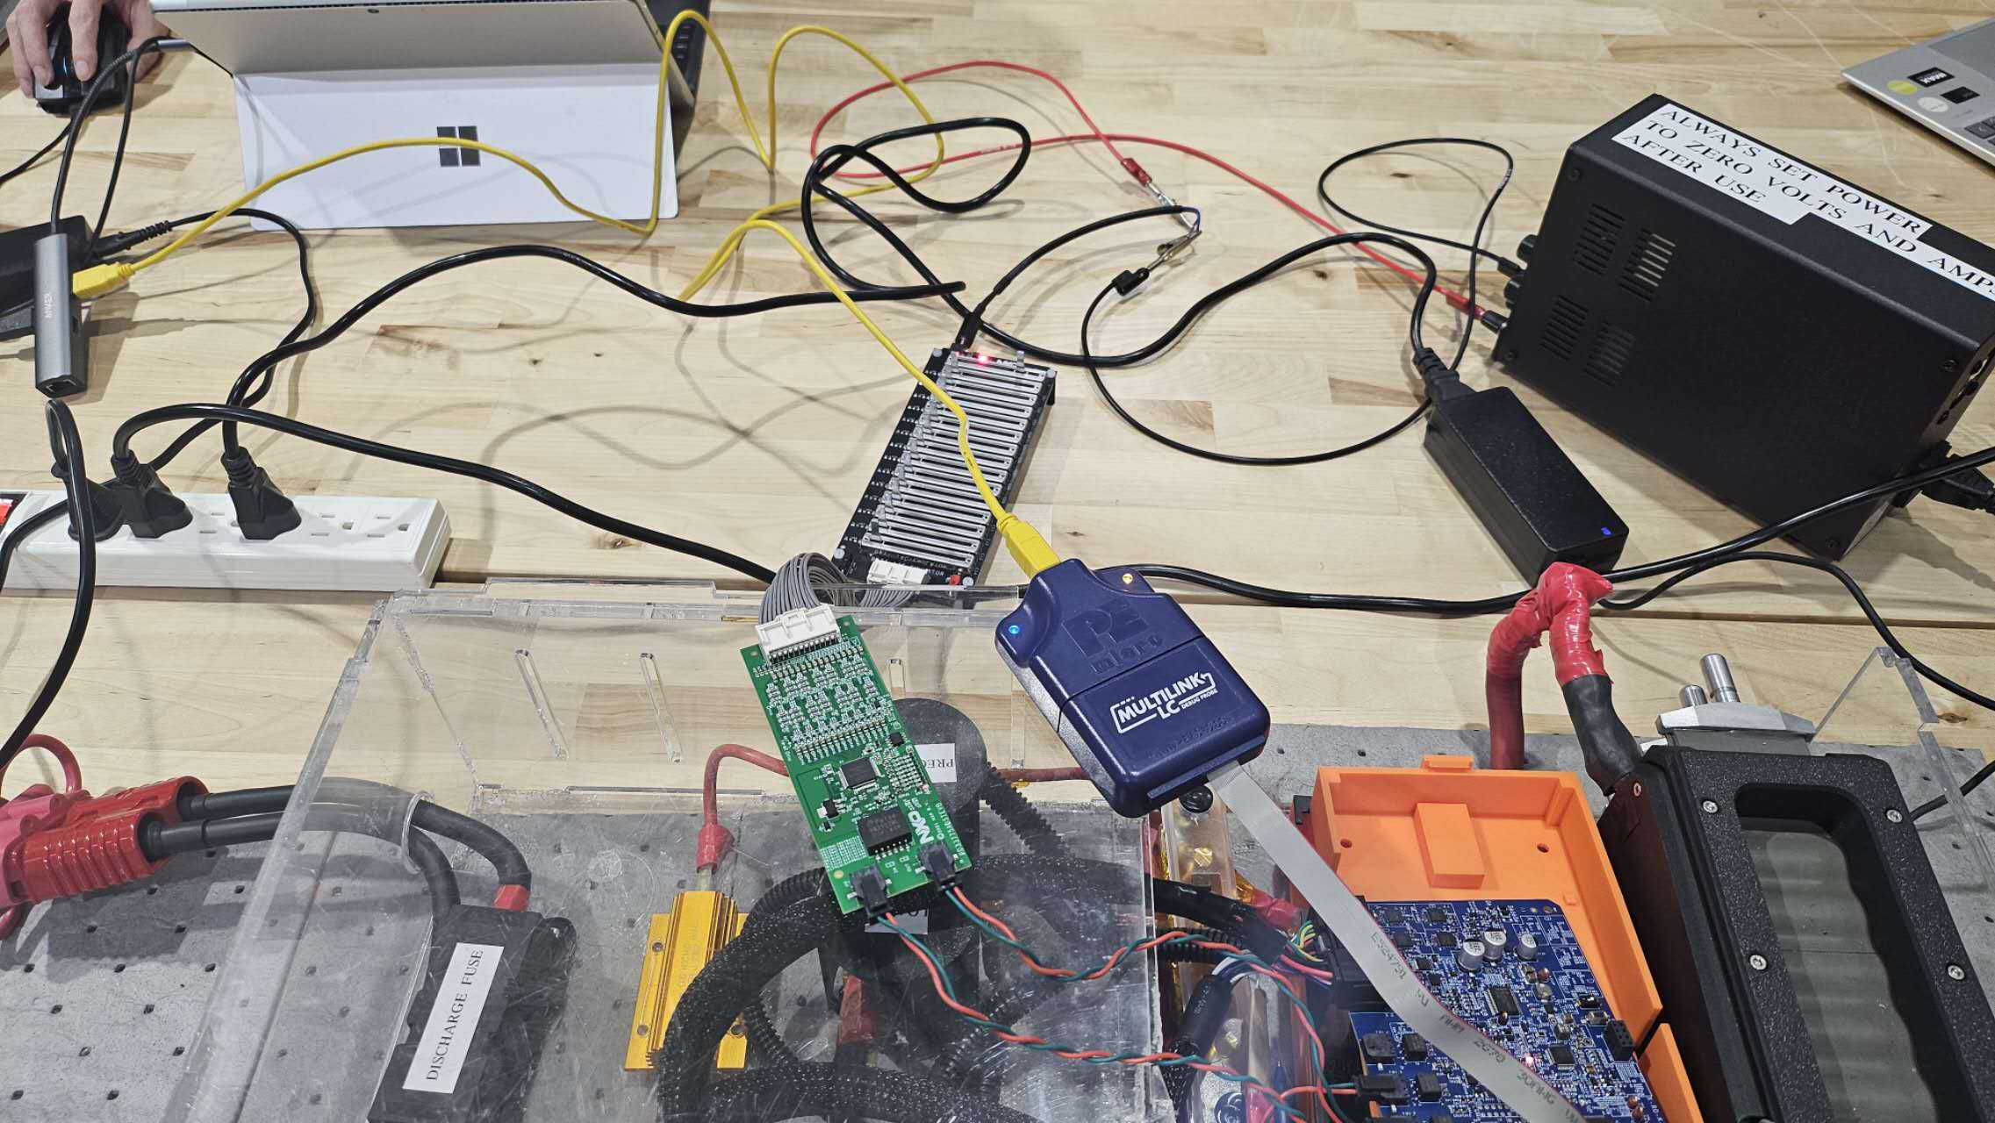
Reference Design Boards Connection
Connections of various hardware components configured by the BWC team in the lab.

Slide 3
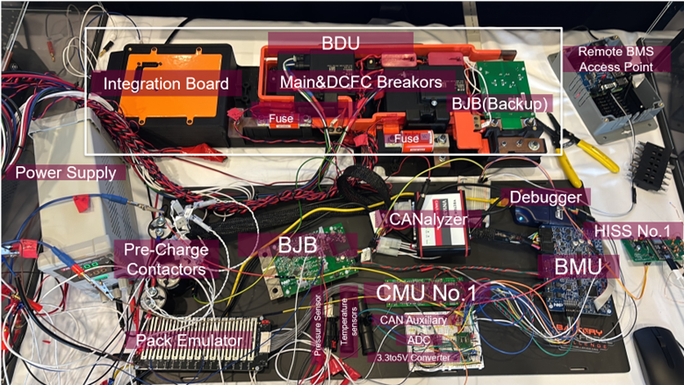
Reference Design Boards Connection
The complete design setup by the BWC team in the lab at the end of Year 2 of the competition.

Slide 4
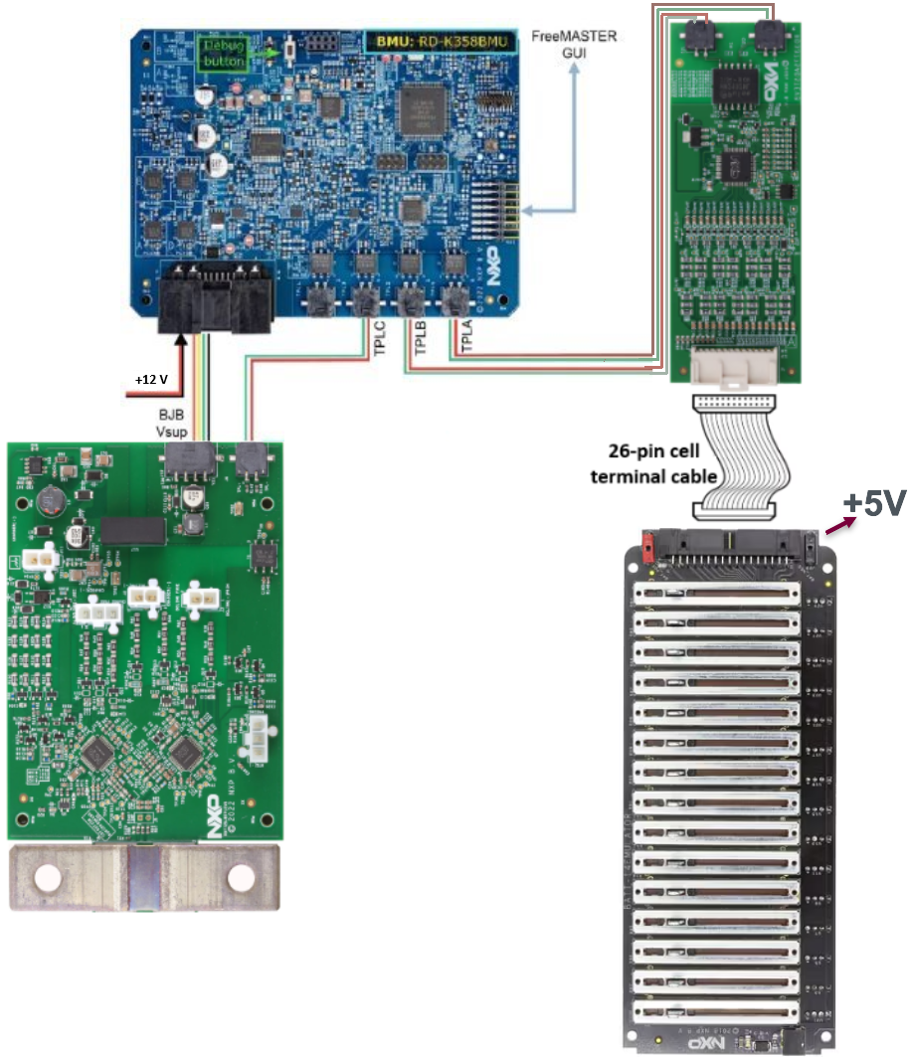
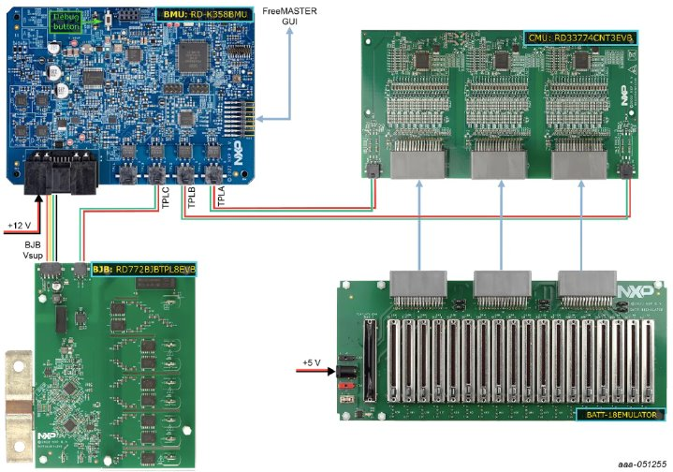
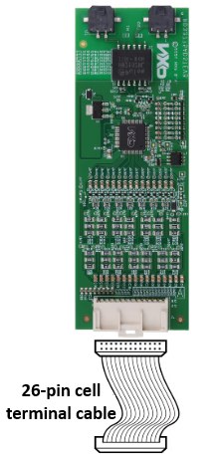
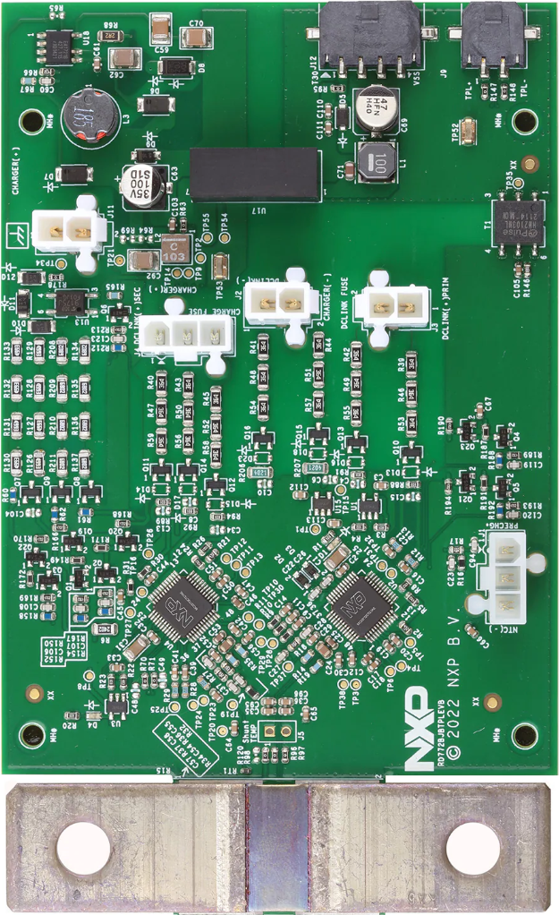
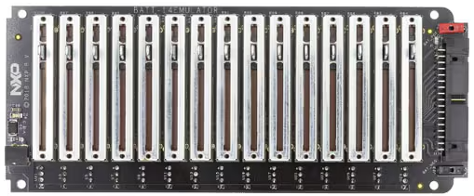
Hardware Configuration (1 of 3)
To connect and power-up the system, complete the following steps:
Connections of the boards
Unpack all boards and cables from the kit
Connect the multipurpose cable to the RD-K358BMU
Connect the CMU
Connect the first ETPL cable to the RD-K358BMU and the RD33775ADSTEVB
Connect the second ETPL cable to the RD-K358BMU and the RD33775ADSTEVB
Connect the three supply cables to the RD33775ADSTEVB and the BATT-14EMULATOR
Connect the BJB
Connect the ETPL cable between the RD-K358BMU and the RD772BJBTPL8EVB
Connect the BJB supply cable between the RD-K358BMU and the RD772BJBTPL8EVB
+5V
Boards Connection

Slide 5
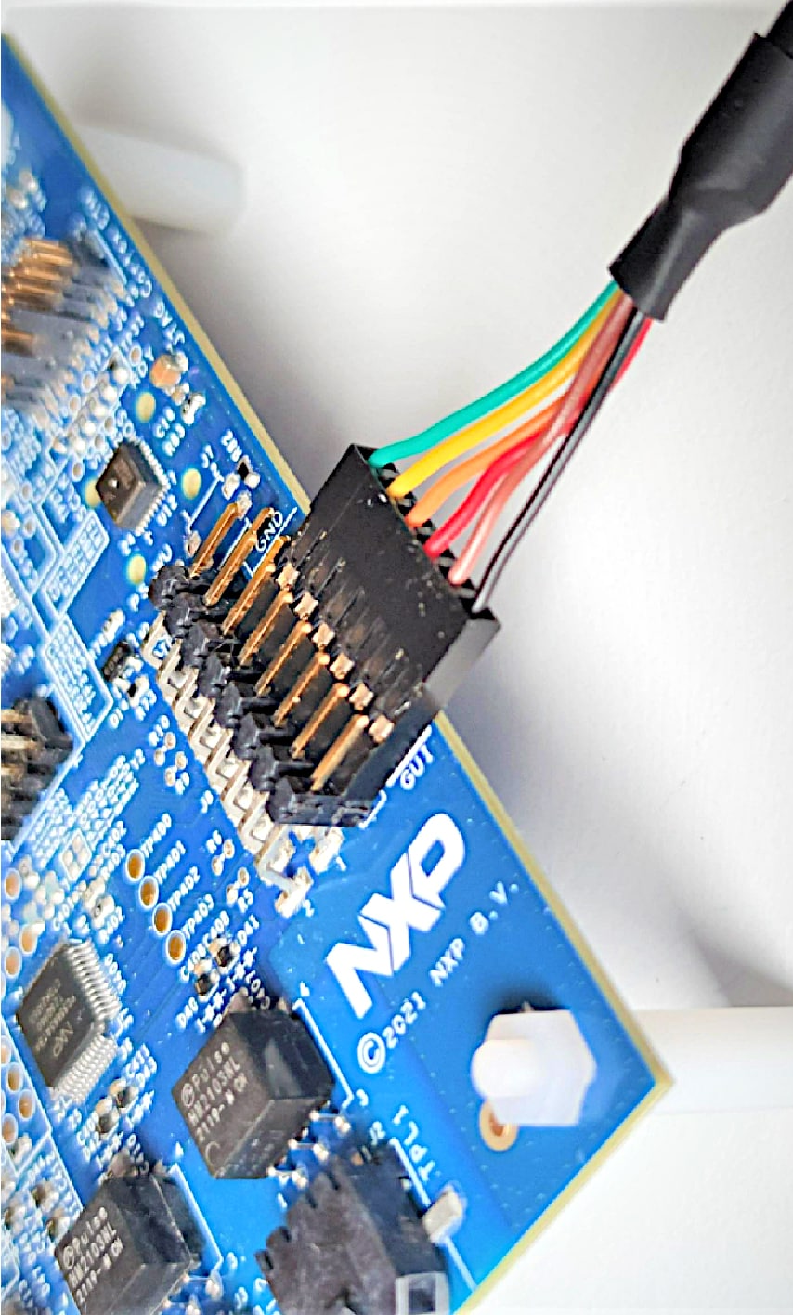
Hardware Configuration (2 of 3)
Powering the boards
Power the CMU by powering the BATT-14EMULATOR using the provided power supply
Power the BMU by connecting the provided power supply to the multipurpose cable end
Monitoring the system using the HVBMS Start-up interface
Open the HVBMS Start-up FreeMASTER project (HVBMS_800_StartUp_FreeMASTER.pmpx)
Connect the provided USB-TTL cable to the RD-K358BMU, ensuring the black wire is on GND, yellow is on TX, and orange is on RX.
USB-TTL cable Connection on RD-K358BMU
Boards Connection
Boards Connection

Slide 6
Hardware Configuration (3 of 3)
In the FreeMASTER menu, click Tools and then Connection Wizard.
In the Connection Wizard window:
Click Next.
Select Use direct connection to onboard USB port and click Next.
Select the correct USB serial port and select 115200 as baud rate to probe and click Next.
Select Yes, use the detected port settings and start using FreeMASTER tool and click Finish.
In the FreeMASTER menu, click Go! or click Connect in the interface.
Programming the system
Boards Connection
Boards Connection
Notes:
To install the development setup and start programming with the HVBMS reference design, refer to the software section of the RD-HVBMSCT800BUN website.

Slide 7
Thank you
McMaster Automotive Resource Centre (MARC)
7

